Slide 1

Mock Population Census of a UK Town in 1881
Data Preparation & Cleaning Process
Oyin Akintoye

Slide 2
Introduction
Data Cleaning Process
Data Features: errors, unique values
Method for fixing data issues
Early Data Insights
Population Demographics
Outlier
Descriptive Statistics
What is next?
Presentation Overview

Slide 3
Introduction
A dataset of a mock census of an imaginary modest town in the United Kingdom for the government to make a decision on:
What to do with an unoccupied plot of land
What infrastructure to invest in for the people
Data collection
Collect the data from the population. Primary data collection from the population through questionnaire
Data Exploration
Reading in the data and then exploring the variables
Data Cleaning
Removing incorrect data and checking for incompleteness or inconsistencies
Summary
Data Modelling & Analysis
Extract meaningful information from raw data for real-world applications and computational purposes
Suggest specific interventions or strategies to address the issues and objectives of the study
Recommendations

Slide 4
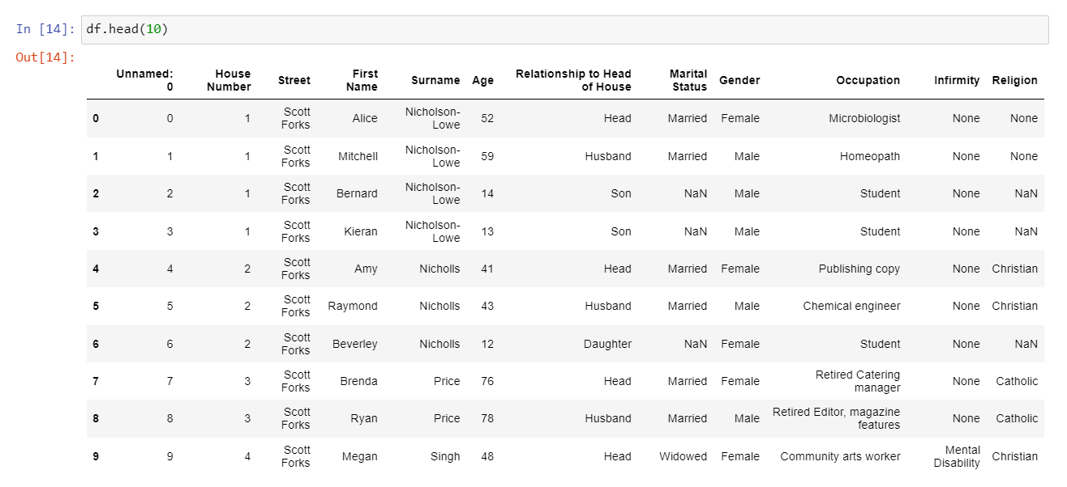
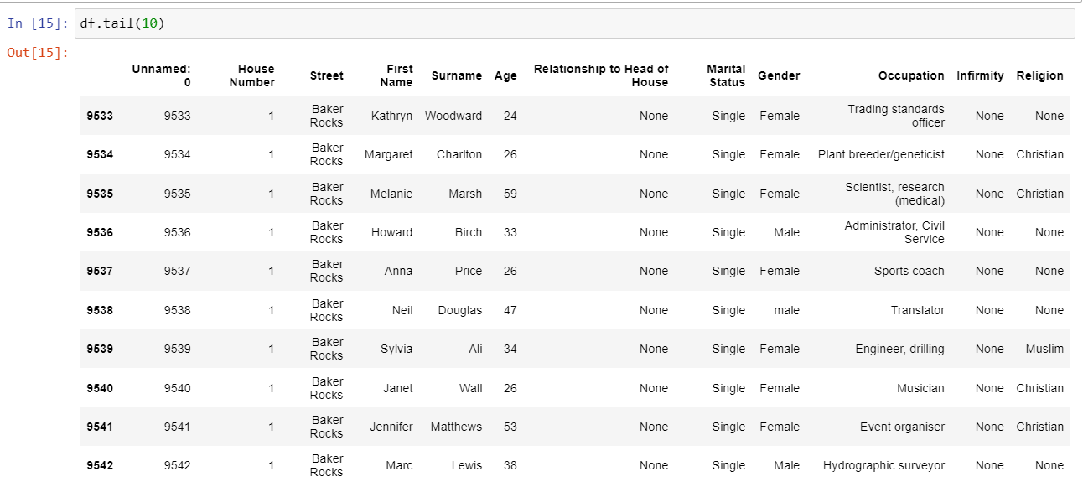
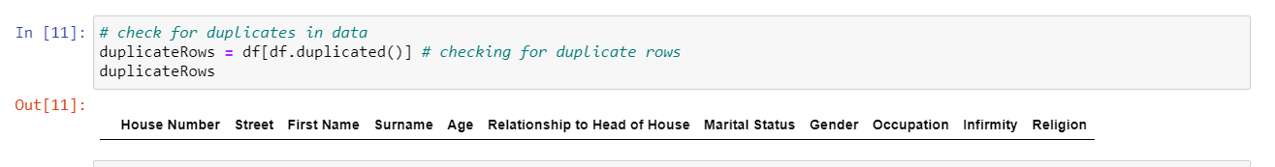
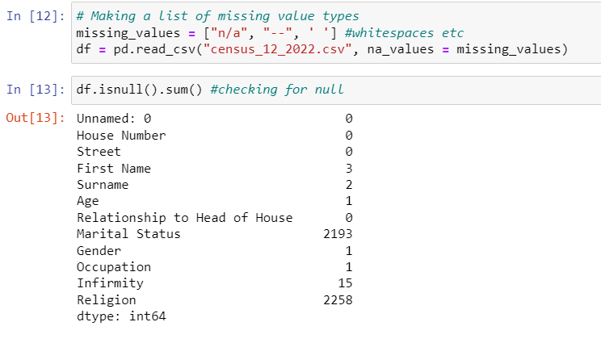
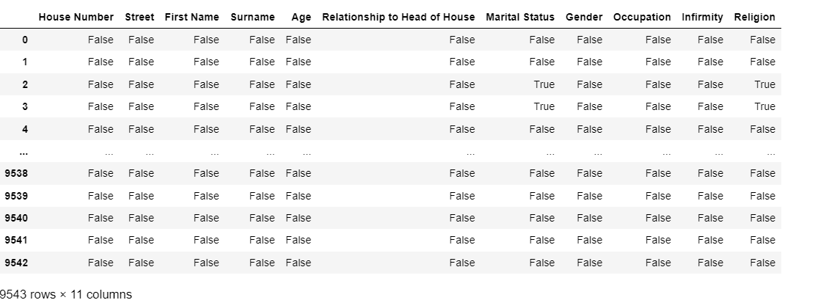
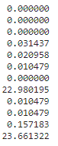
Data Exploration
Activities
Read data file
Summary of dataframe
Inspect the data
Marking empty values as missing
Missing value types
Check duplicates
Current Future
Current State

Slide 5
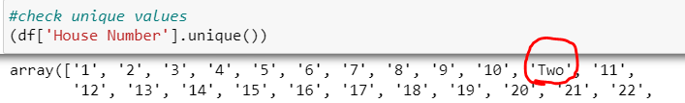
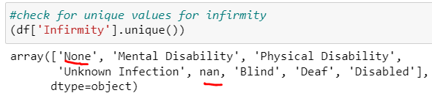
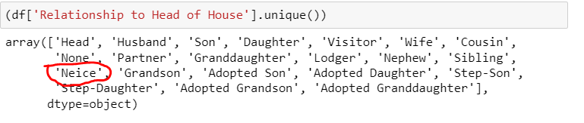
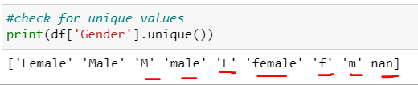
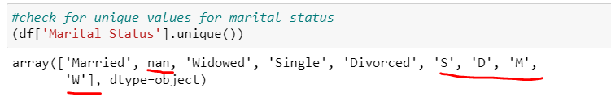
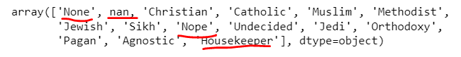
Data Features
Null Values, Blanks
House Number
Surname -whitespace
First name- whitespace
Age - blank
Relationship to Head of House - Misspelling
Marital Status - blank
Gender
Occupation - blank
Infirmity
Religion
Current Future
Current State

Slide 6
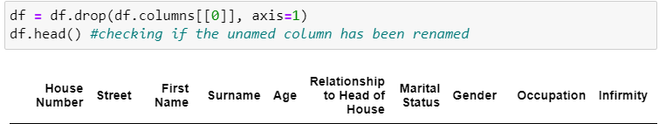
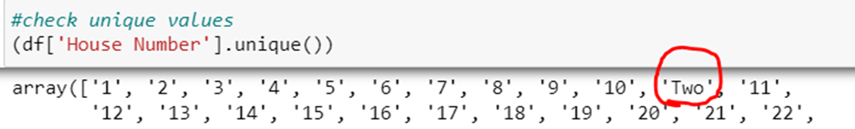

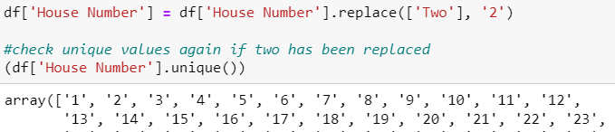
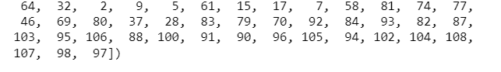
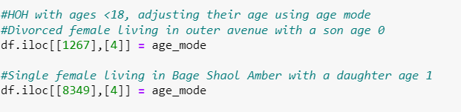
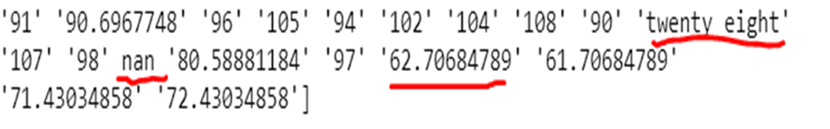
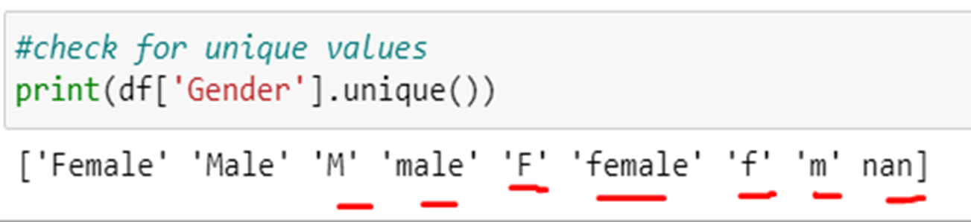
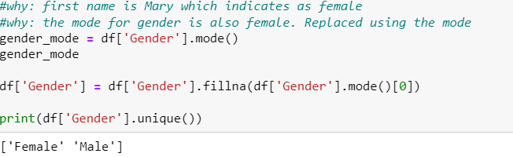
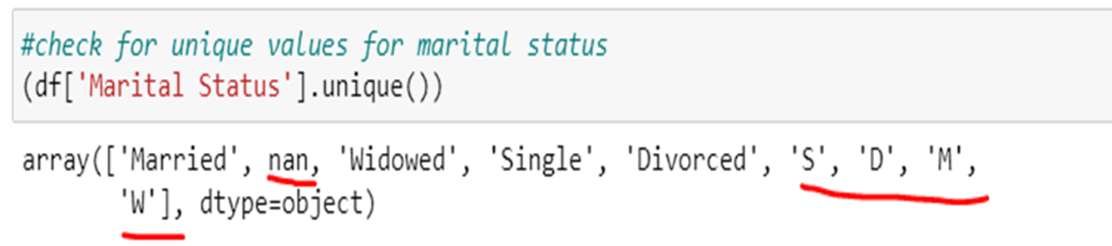
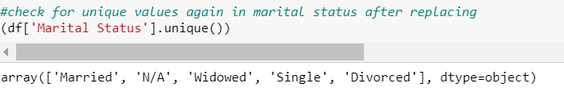
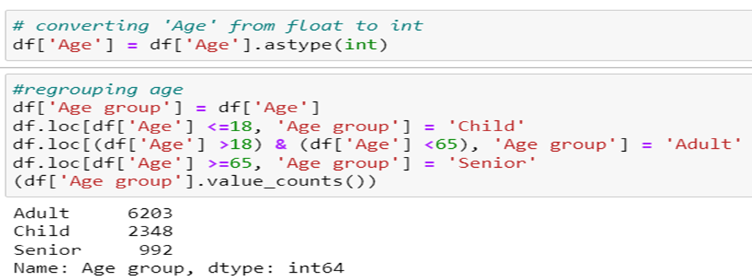
Method for Fixing Data Errors
Drop unused column
Imputing missing values using statistics: df[‘column name’].fillna()
Infer from the most common population demographics/feature e.g: mode
Using statistics to define normal data and identify outliers
Categorical features require cleaning: df[‘column name’].replace()
Convert data type: Strings to numerical

Slide 7
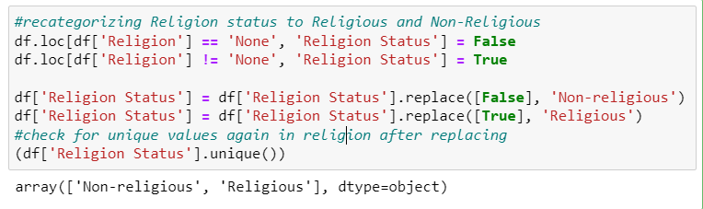
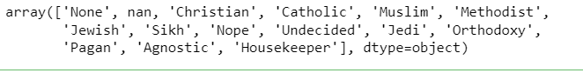

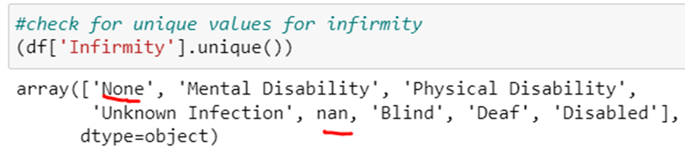
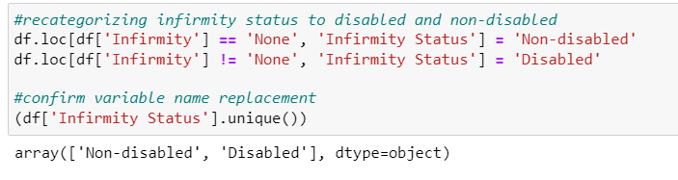
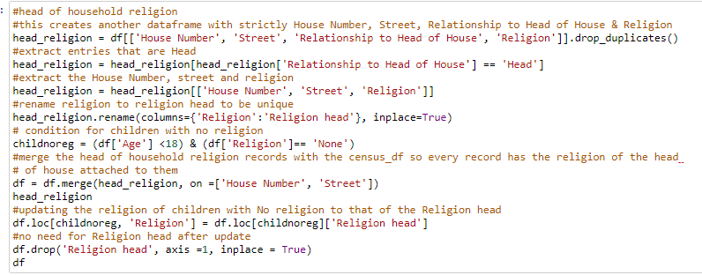
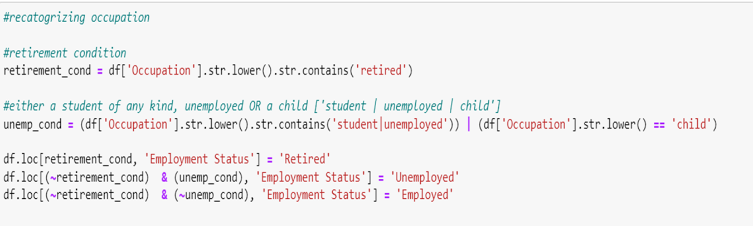

Slide 8
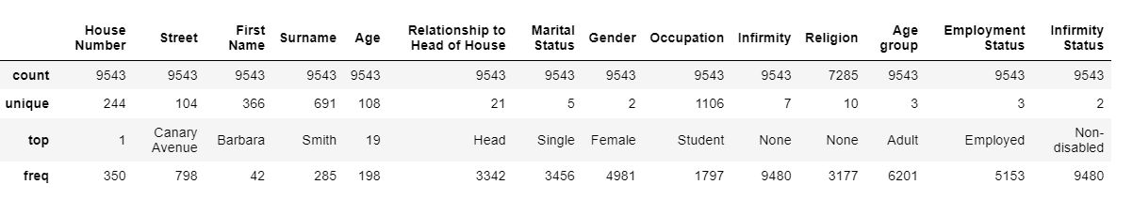
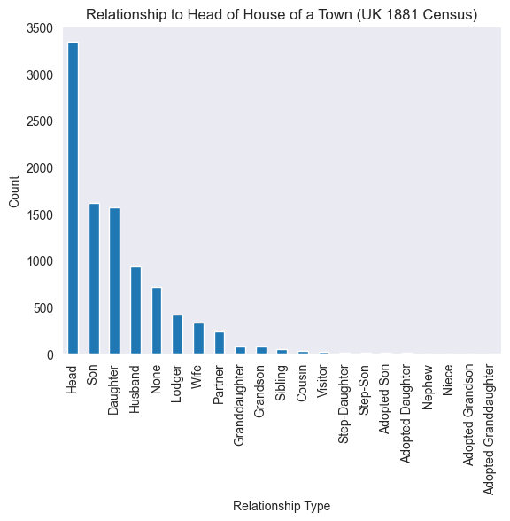
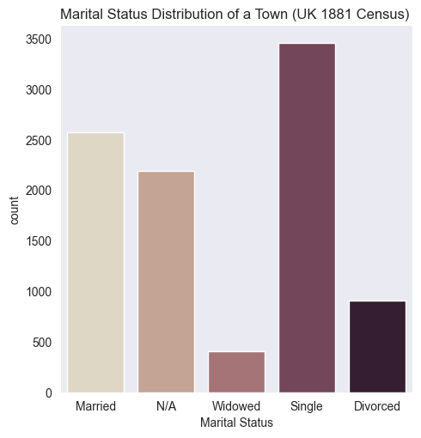
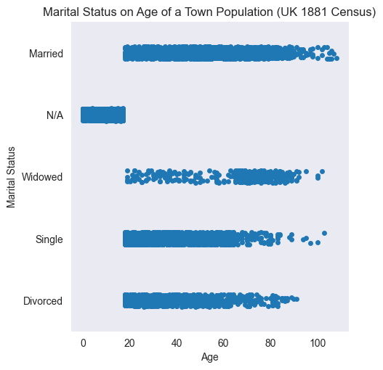
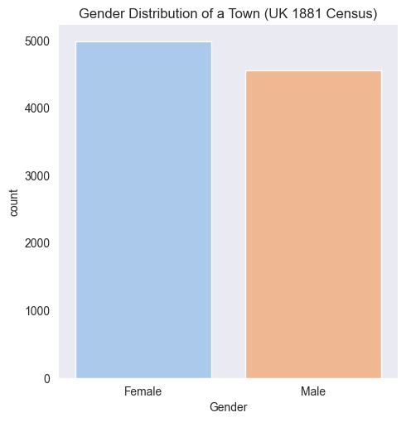
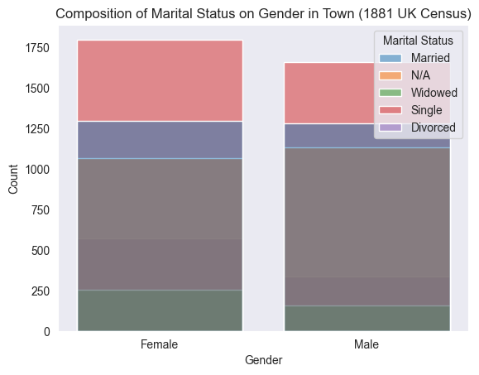
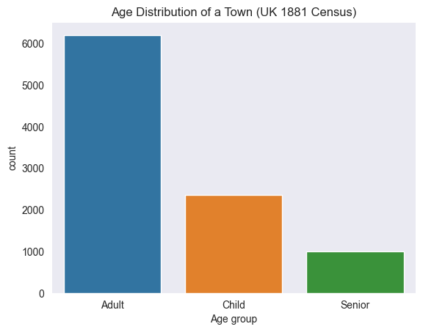
Data Insights

Slide 9
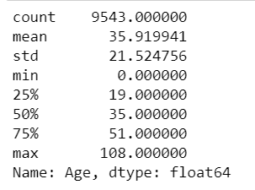
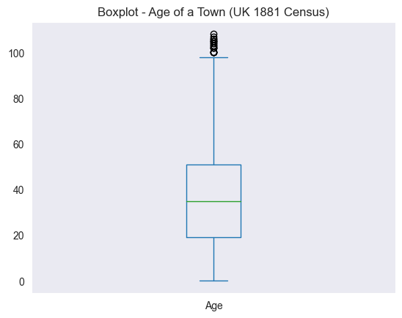
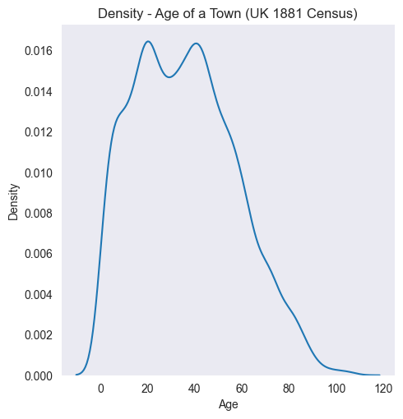
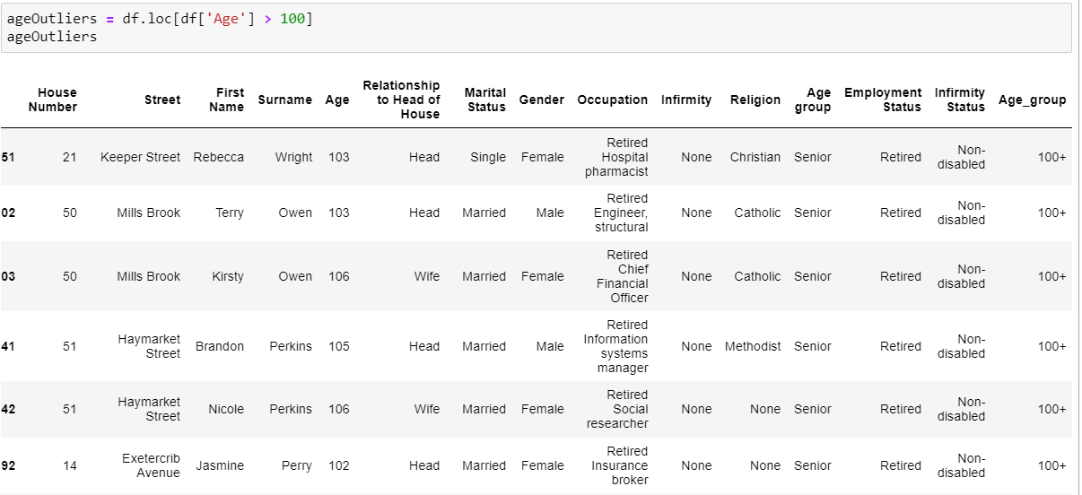
Data Insights

Slide 10
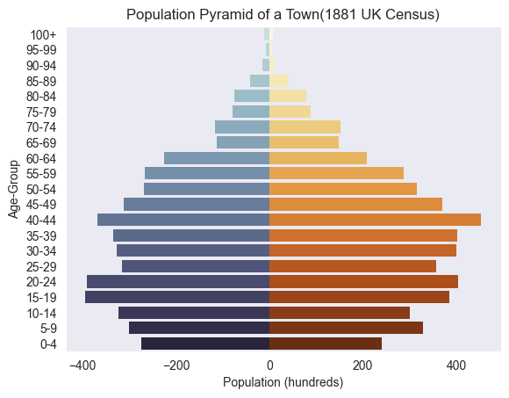
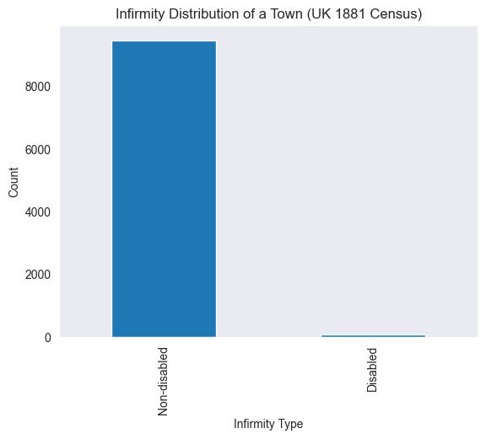
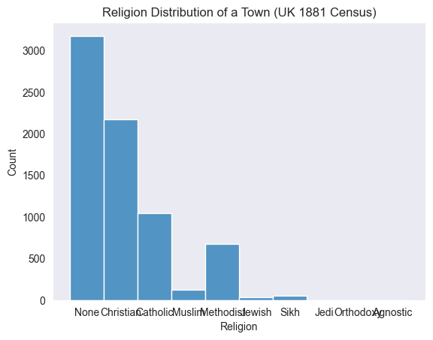
Data Insights
Male
Female

Slide 11
Unoccupied plot
High or low density housing
Train station
Religious building
Emergency medical building
Something new
Investment options
Employment & training
Old age care
Increase schooling funding
General Infrastructure
Questions
How many people per house
Divorce and marriage rate
……
Next Steps

Slide 12
Thank You
Oyin Akintoye

